Slide 1
Basics of Cartography

Slide 2
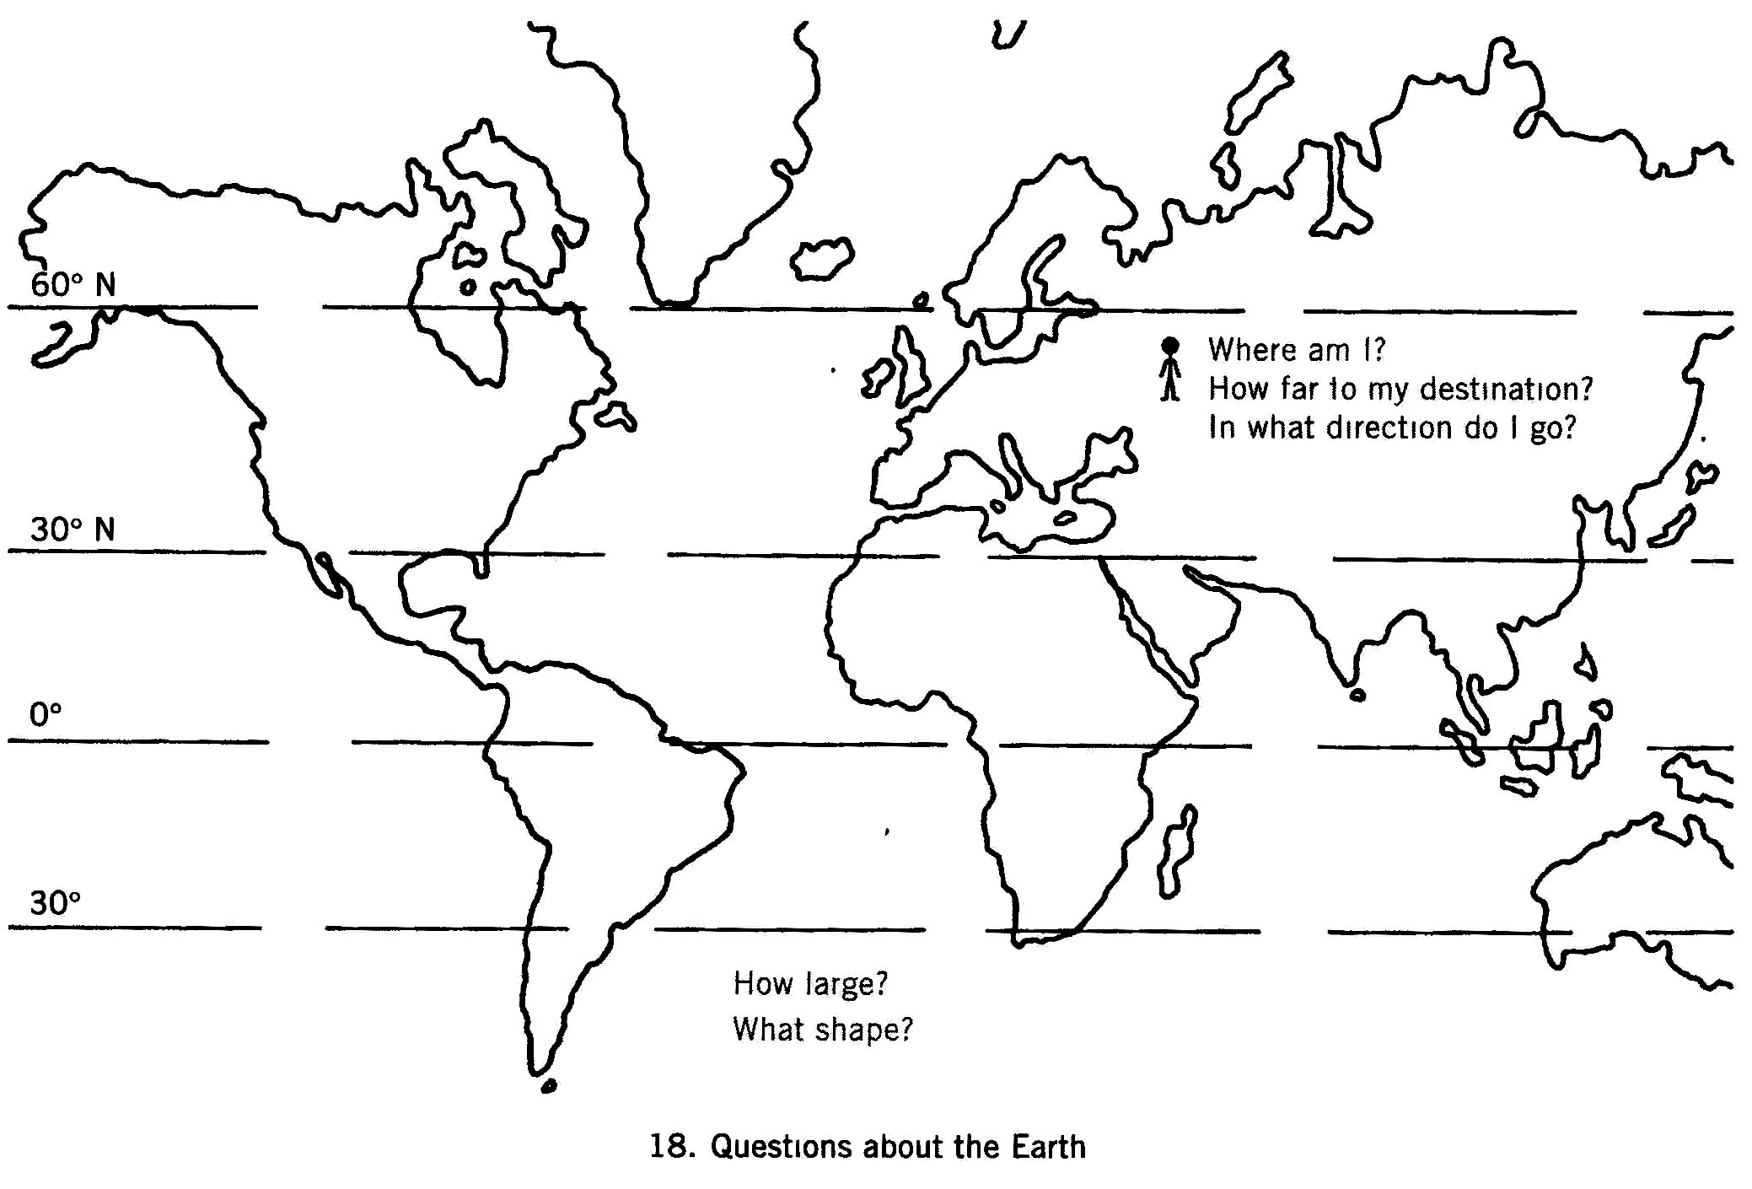
CARTOGRAPHIC BASICS
Where am I?
How far to my destination?
In what direction do I go?
How large?
What shape?

Slide 3
Introduction
This presentation covers:
an introduction to scale maps, what they are and how they are made;
basic cartography – standard conventions in making maps.
Notes:
This Unit is a prerequisite for subsequent Units in Module 9 and thus this presentation serves as an introduction to the Module.

Slide 4
What is a scale map?
A map drawn using measurement
Shows a distance measured on the ground according to a certain proportion
Measures direction also
Any point on the map has a relationship to any other point according to a measured distance and direction
Notes:
You might pose questions to the group (e.g. “Have you had any experience with scale maps?”). Be prepared with examples of scale maps that you can show around the room.

Slide 5
What is cartography?
Cartography is the art and science of making maps.
There are standard cartographic conventions for making scale maps.

Slide 6
Basic elements of a scale map
Symbols and a legend
Scale
Direction (indicated by the north arrow)
Map grid or coordinate system
About the map (date created, title, author, source information)
Notes:
Have an example of a topographic map on the wall and point out, or have a participant point out, each of these elements.

Slide 7
Why use symbols on a map?
Words alone would clutter the map.
Symbols can help organise the information.
Symbols can depict complex ideas or things.
The legend or reference explains the symbols.
Notes:
Discuss symbols. What are common symbols seen around us each day? An example is symbols on road signs. Why are symbols used on road signs? To convey a message quickly! There is a saying that “a picture is worth 1,000 words”.

Slide 8
Types of maps
Base maps show where something is in space.
Thematic maps tell the story about the place.
Notes:
Base maps are like the skeleton. All the other information on the map is structured and located according to the skeleton.

Slide 9
Base maps
Base maps are reference maps. They contain:
reference features such as rivers, roads, terrain and settlements;
cartographic references such as a coordinate system, north direction and scale.
Notes:
Show examples of one or more base maps.

Slide 10
Types of base maps
Topographic maps
Radar image maps
Aerial photo maps
Satellite image maps
River maps

Slide 11
Thematic maps
Depict a specific theme or subject about a certain geographic area
Illustrate physical, social, political, cultural, economic, sociological, agricultural or any other aspects of a place
Notes:
If possible, mount some examples of thematic maps on the walls of the “classroom”. Discuss the theme of each map. What are the elements in the legend that illustrate that theme? Ask participants what themes may be relevant to their prospective mapping project. Which existing thematic maps (i.e. thematic maps made by government or industry) are relevant to their prospective mapping project?

Slide 12
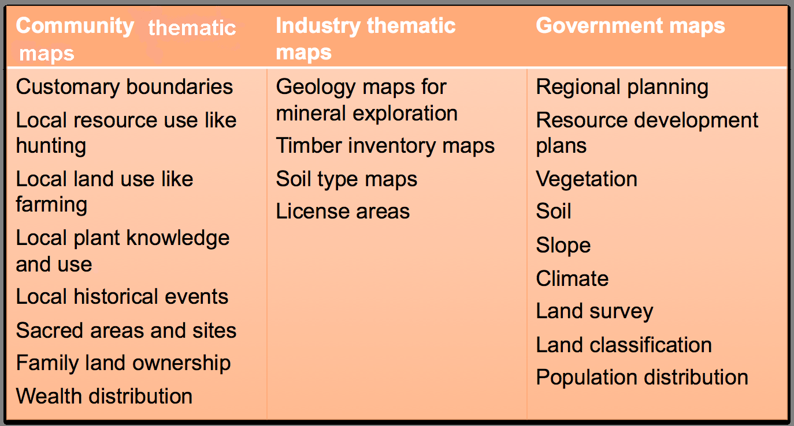
Examples of thematic maps

Slide 13
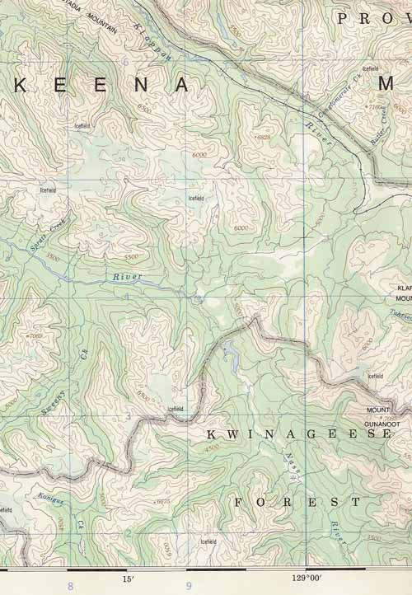
Topographic maps
Most common kind of base map
Topography means shape and elevation of the land
Topography is shown with contour lines
Notes:
In this Unit, there are several exercises for reading topographic maps. This part of the presentation serves as a brief overview. If there are no topographic maps for the area or nation in which this training is taking place, then the presentation and exercises about contour can be skipped.

Slide 14
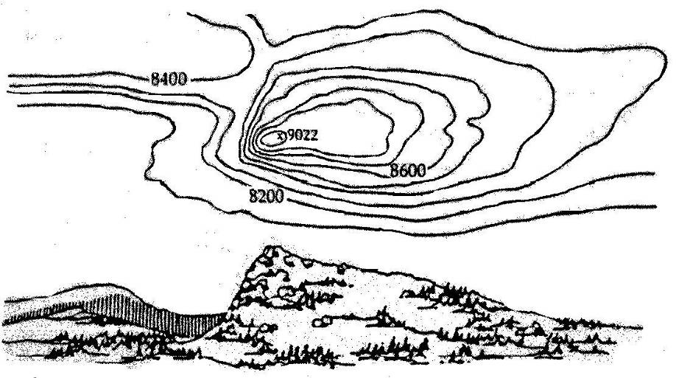
Contour lines
Indicate height or elevation of the land above sea level

Slide 15
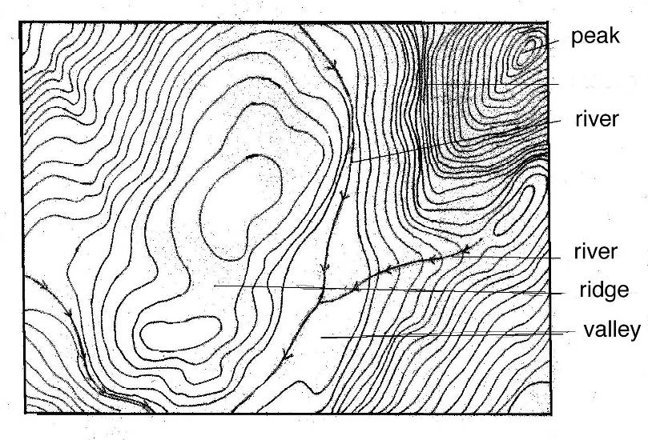
Contour lines
Pattern of the contour lines show the shape of the land
Note that contour lines:
are never straight;
never cross each other;
always cross rivers.

Slide 16
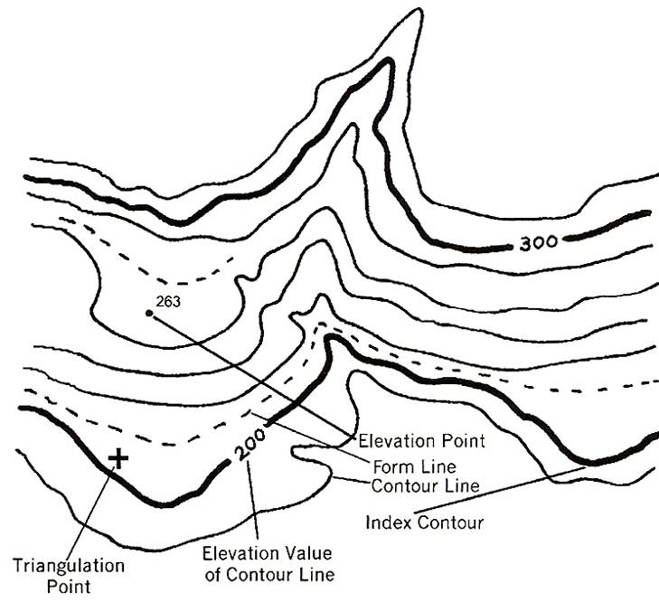
Contour interval
The vertical distance between two adjacent contour lines
The same for all the contour lines on the map
Depends on the scale of the map

Slide 17
What does scale mean?
Scale is about distance. How long? How far? How wide? How far on the map and how far on the ground?
A map drawn to scale means that the distance between any two points on the drawing is in proportion to the distance on the ground.
Notes:
Scale also refers to models. Bring in a toy motorbike. Measure the length of a toy motorbike and measure the length of a real one in centimetres. How many times bigger is the real motorbike than the toy one? That is the scale. Use any kind of object in different sizes to demonstrate this.

Slide 18
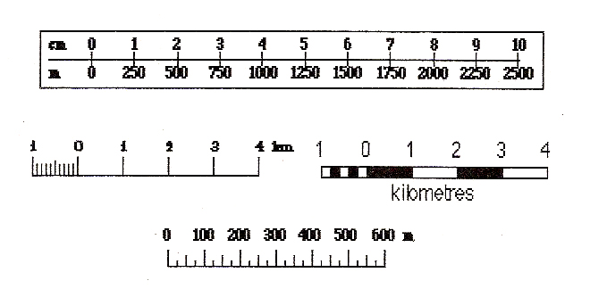
How is scale written?
A fraction scale looks like this: 1:25,000.
It is written or said like this: “one to twenty-five thousand scale”.
It is shown as a graph scale like this:
Notes:
Graph scales are drawn with different designs but they all have a bar showing the actual scale distance. Note that it is best practice to draw a graph scale when creating a map because then the actual scale can always be determined if photocopies are made, a digital photo is taken or the scale is changed.

Slide 19
1:25,000 scale
1 centimetre (cm) on map = 25,000 cm on the ground
1 cm on the map = 250 metres (m) on the ground
4 cm on the map = 1 kilometre (km) on the ground
Notes:
The fraction scale tells us about the scale of the map algebraically.

Slide 20
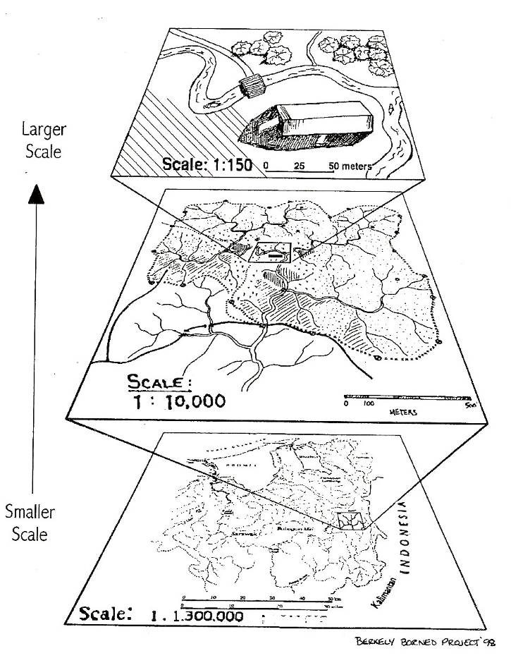
Relative scale
Maps may be small, medium or large scale
Large scale map: smaller area, more detail, more specific
Small scale map: larger area, less detail, more general
Notes:
Discuss relative scale. If there are sample maps in the classroom, discuss which ones would be considered small scale and which would be medium or large. Look at the table in the handout about the size of land area for a small, medium or large scale map. Discuss the relative scale that map participants will make in their prospective mapping project.

Slide 21
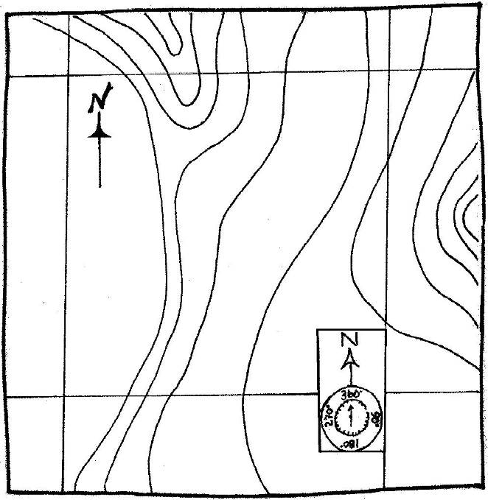
Direction on a map
Why draw maps with north at the top? It is a standard convention.
Compasses are made to measure to the magnetic north pole of the Earth.

Slide 22
Where is north?
We are facing north when our left hand points west where the sun sets and our right hand points east where the sun rises.
We use a compass to measure the location of north; the magnetic needle always points to north.
Notes:
Discuss with the group the local convention for talking about direction. Is there a local concept for north, south, east and west? Are there landmarks that are used for orientation instead? Are people accustomed to looking at the stars or the sun for direction?

Slide 23
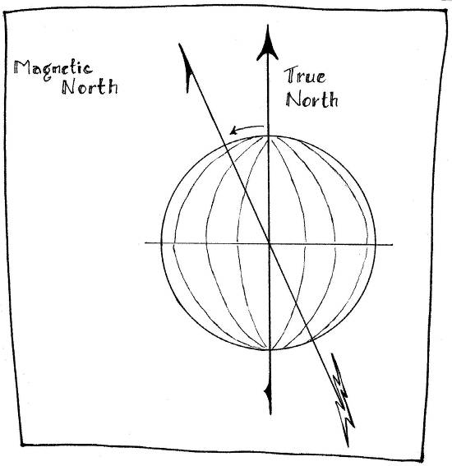
North on the map
Magnetic north is measured by a compass.
Grid north follows the grid lines of the coordinate system the map is made on.
True north corresponds to the Earth’s axis, the North Pole.
Notes:
Understanding the difference between magnetic north, grid north and true north is particularly relevant if using a magnetic compass with a map. If not using a compass, it is sufficient to be able to identify the grid lines.

Slide 24
Magnetic declination
The difference or angle between magnetic north and true north
The calculation for the difference is shown on a topographic map
Adjust your compass accordingly

Slide 25
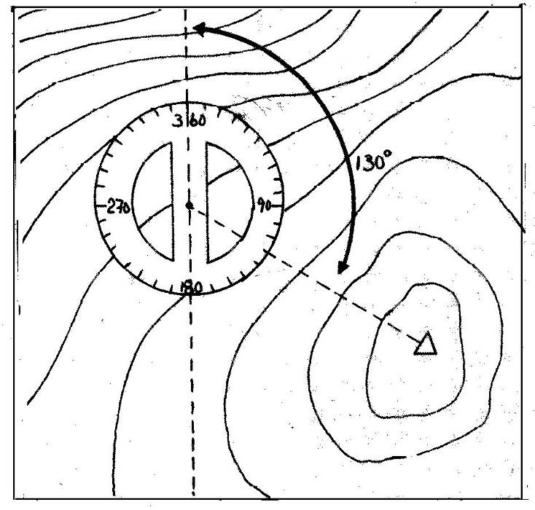
Measure direction on a map
Use a protractor or compass to measure the degrees or angle from the north line
Both measure using a circle of 360 degrees

Slide 26
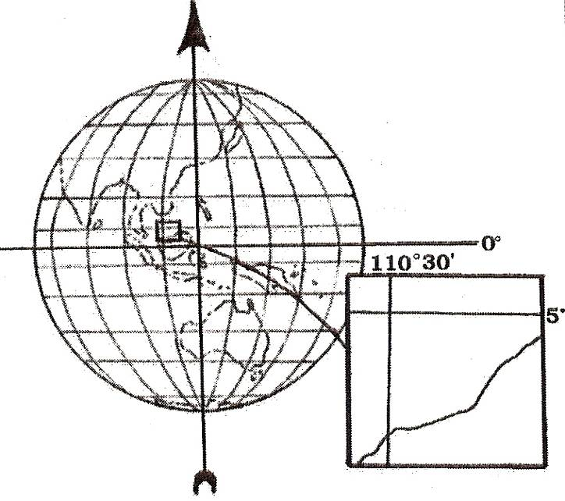
The map grid
Imaginary lines crossing the globe
Meridian lines are drawn north-south
Parallel lines are drawn east-west
Where the lines cross is a coordinate point
Notes:
Understanding the map grid is particularly important if participants will be using GPS or digital GIS. If possible, have a globe available to show the grid. Exercises 9 and 10 on coordinate systems will help with understanding coordinate points and grid systems.

Slide 27
Coordinate systems
Two common coordinate systems are:
the geographic coordinate system
the Universal Transverse Mercator (UTM)

Slide 28
Geographic coordinate system
Latitude lines run east-west and are parallel.
Longitude lines run north-south.
Lines are numbered in degrees, minutes and seconds, like reading a clock.
Why degrees? Because angles are always measured in degrees.
Notes:
This is best shown on a three-dimensional globe.

Slide 29
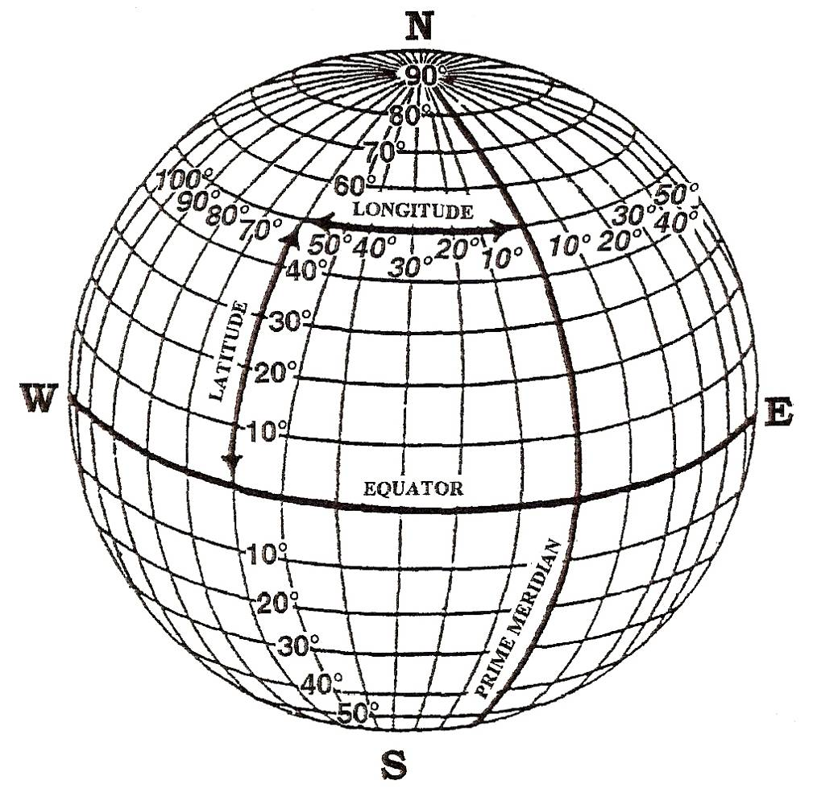
Latitude-Longitude

Slide 30
Universal Transverse Mercator (UTM)
On a global map, UTM lines are straight.
UTM is a type of projection, calculated to make a flat map of the round Earth.
UTM zones are numbered east to west and lettered north to south.
Each zone is equivalent to 6º.
The measurement unit is metres.
Notes:
See Exercise 10, “Coordinate Systems and Projections”. Alternatively, it may be conducted as a demonstration at this point in the presentation.

Slide 31
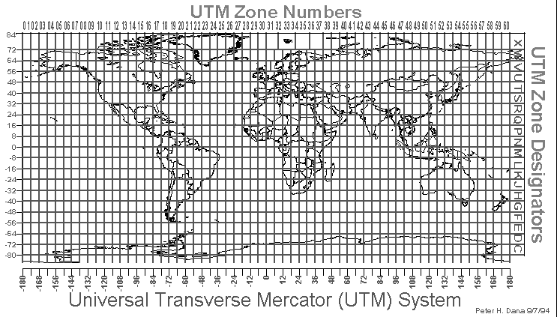
UTM
Notes:
This diagram of the UTM grid system shows how the 3-D globe is flattened to make a 2-D map. The UTM grid provides a convention for locating places on the globe and also for creating local maps that accord with the convention.

Slide 32
Strengths of scale maps
Can measure distance, direction and area
Made according to conventions so they have validity in the eyes of officials
Objective viewpoint leads to clear discussion between community and “outsiders”
Notes:
Discuss the strengths of scale maps. Before showing this slide, ask participants for their ideas about the strengths of scale maps in their own words.

Slide 33
Limitations of scale maps
Community members may not understand the map or the process.
It is difficult to draw the local perception of the land and the subjective importance of things.
Discussions with officials may get diverted to technology and accuracy and away from the real issues.
Notes:
Discuss the limitations of scale maps. Before showing this slide, ask participants for their ideas about the limitations of scale maps in their own words.

